Slide 1
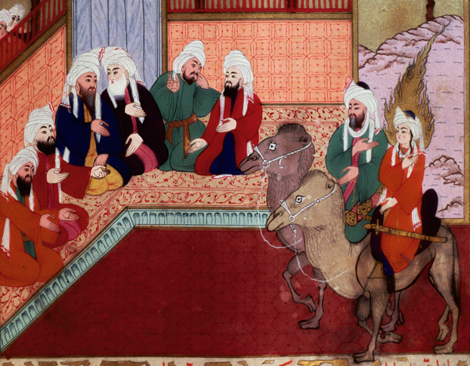
The Muslim World and Africa (730 B.C.-A.D. 1500)
Lesson 1 The Origins of Islam

Slide 2
The Muslim World and Africa (730 B.C.-A.D. 1500)
Lesson 1 The Origins of Islam
Learning Objectives
Understand how Muhammad spread Islam.
Describe the central ideas of Islam.
Explain how Islam helped shape the way of life of its believers.

Slide 3
Muhammad and Early Islam
Muhammad’s Early Life
Born in Mecca around 570 AD
Mecca was a safe city b/c of the Kaaba, an ancient temple that made everyone leave their weapons near the temple
He was a shepherd at first then a merchant
At 25 he marries Khadija, a widow who had a caravan business
Muhammad the Messenger
At age 40 while meditating in the hills, he hears the Angel Gabriel asking him to be the messenger of God
Khadija convinces him to answer the call, becoming the first Islamist
Islam means to submit to God in Arabic
He ask Arabs to worship God instead of Pagan Gods

Slide 4
Muhammad and Early Islam
The oasis of Mecca was an important religious site with a major temple dedicated to pagan gods and goddesses. Its religious significance helped make it a thriving merchant center.

Slide 5
Muhammad and Early Islam
The Hijra: From Mecca to Medina
Arabs did not want to worship Allah and persecuted Muhammed and his followers. Some leave to Axum, a Christian kingdom
In 622 under a death threat Muhammed leaves and goes to Yathrib
Later on Yathrib will be called Medina or City of the Prophet
Medina will prosper under Muslim rule, angering Mecca, triggering a war
Return to Mecca
Muhammed returns to Mecca in 630 victorious
He destroys all the pagan idols in the Kaaba and rededicates it to Allah
He works to unites all the Arabs under Allah, dies in 632

Slide 6
Teachings of Islam
The Quran
Sacred word of God as revealed to Muhammed
Emphasizes honesty, generosity, and social justice
Belief that on Judgement Day people will either face eternal punishment or eternal bliss
Arabic is the language of the Quran so it must be learned in order to better understand it
The Five Pillars of Islam
1st: Declaration of faith. There is no god but God; Muhammed is his messenger
2nd: Pray 5 times daily, facing Mecca
3rd: Give Charity to the Poor
4th: Fast from sunrise to sunset during the holy month of Ramadan
5th: Make a pilgrimage to Mecca if able once during their life

Slide 7
Teachings of Islam
“People of the Book”
According to Muslim belief Muslims, Jews, and Christians worship the same God
Hebrew scriptures and Christian bible have earlier revelations
Jews and Christians are People of the Book, having spiritual superiority than pagan worshipers

Slide 8
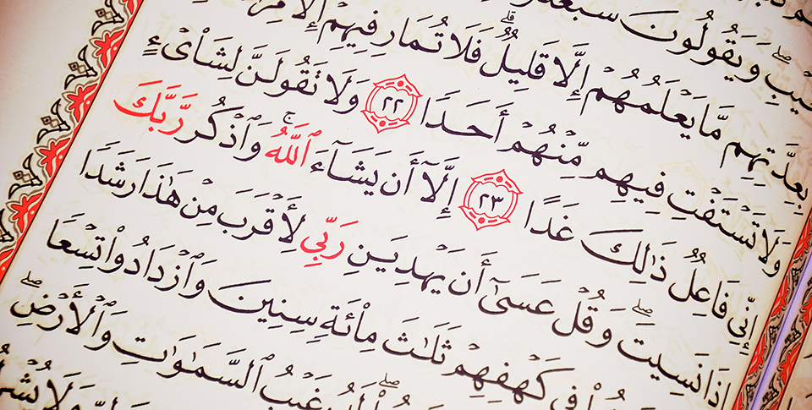
Teachings of Islam
The Quran contains 114 suras, or chapters. This page shows a portion of the Cave Sura, named after its story about God protecting persecuted people by causing them to sleep safely in a cave.

Slide 9
Islam as a Way of Life
Islamic Law
Sharia – body of laws that includes interpretations of the Quran, Muhammed’s behavior in his life, and Muslim tradition
Similar to Jewish law
Does not separate religion from civil or criminal law but applies religion to all legal situations
Women in Early Muslim Society
Islam extends rights and protection to women by affirming the spiritual equality of all Muslims
Quran: prohibits the killing of daughters, granted the right of women to inherit, and allowed women to reject a marriage offer
Also encouraged education to all so they could study the Quran

Slide 10
Islam as a Way of Life
Islamic Practices Change
As Islam spreads, Muslims adopt practices of conquered people
An example is Persians veiling their women and secluding them to a part of the home.
Quran says women should dress modestly but that is open to interpretation
In rural areas peasants needed to work and could not wear a veil but dress modestly

Slide 11
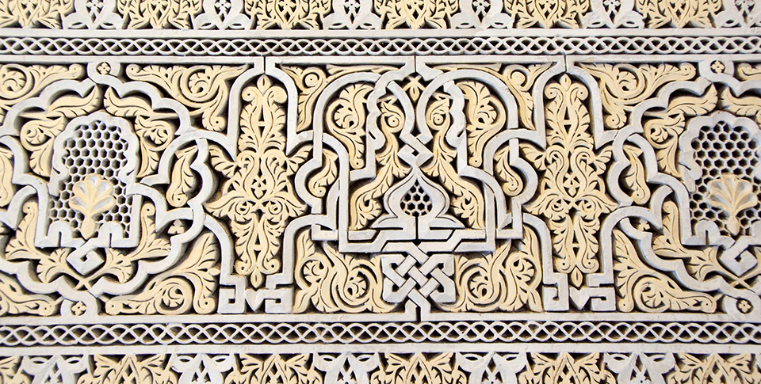
Islam as a Way of Life
Like the Quran and the Arabic language, Islamic law also served as a unifying element for many of the empire’s Muslims. There are many ornate stone carvings in the Mahakma Law Courts, home to the Islamic law courts in Morocco.

Slide 12
Quiz: Muhammad and Early Islam
What event led Muhammad to undertake the hijra from Mecca to Medina?
A. Muhammad believed that he received a message from God telling him to do so.
B. Muhammad faced threats on his life in Mecca.
C. Muhammad wanted to build a Kaaba in Medina.
D. Many Muslims already lived in Medina.

Slide 13
Quiz: Teachings of Islam
The Five Pillars of Islam are central to the religion of Islam because they
A. are requirements that all “People of the Book” must follow.
B. are a way of showing increased status in the Muslim community.
C. make up the complete sacred text for believers in Islam
D. are the most important requirements for practicing the Islamic faith.

Slide 14
Quiz: Islam as a Way of Life
The best place for Muslims to find guidelines for solving legal issues is
A. the Five Pillars.
B. any holy text.
C. Sharia.
D. the Quran.

